Slide 1

Retail Insights from Superstore Data
Sarthak Singh Kshatriya
MIT ADT University
AICTE ID- STU6583391db96991703098653

Slide 2

PROBLEM STATEMENT
The superstore faces challenges in efficiently analyzing its extensive data, resulting in suboptimal sales performance, limited understanding of customer behavior, and poor inventory management.
This project seeks to address these issues by conducting a comprehensive analysis of the dataset, providing clear insights and actionable recommendations to enhance decision-making, boost efficiency, and increase profitability.

Slide 3
Project Description This project aims to analyze a superstore's dataset to discover insights related to sales performance, customer behavior, and inventory management. By identifying key patterns and trends, the project will provide actionable recommendations for optimizing operations, improving customer satisfaction, and boosting overall profitability. The insights gained will support strategic decision-making, enabling the superstore to maintain a competitive edge in the market. The Exploratory Data Analysis (EDA) methodology will be employed to extract these valuable insights from the dataset.

Slide 4
Methodology used:
Data Collection: Gather the dataset from the superstore's records, ensuring it includes relevant variables such as sales, customer demographics, product categories, and inventory levels.
Data Cleaning: Clean the data by handling missing values, correcting inconsistencies, and removing duplicates to ensure accuracy and reliability.
Exploratory Data Analysis (EDA): Perform an initial examination of the data to understand its structure and key characteristics. Use descriptive statistics and visualization techniques to identify trends, outliers, and patterns.
Statistical Analysis and Modeling: Apply statistical methods to analyze the data. Techniques such as regression analysis and clustering will be used to uncover relationships and predict future trends.
Visualization and Reporting: Create visualizations such as charts, graphs, and dashboards to present the findings clearly and intuitively. Compile a comprehensive report that summarizes the insights and provides actionable recommendations

Slide 5
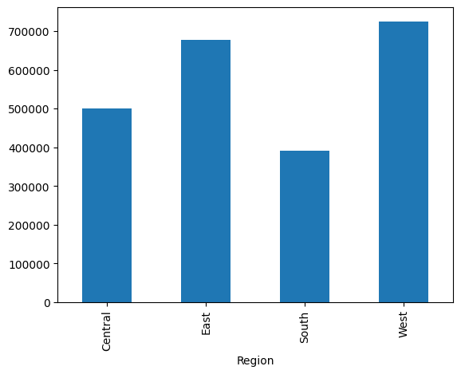
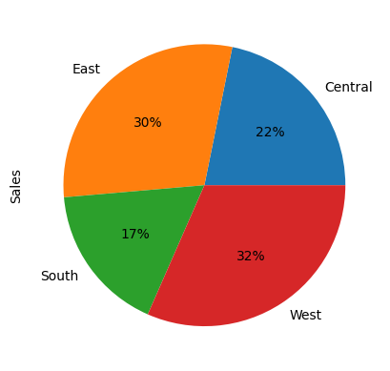

EDA Results:

Slide 6
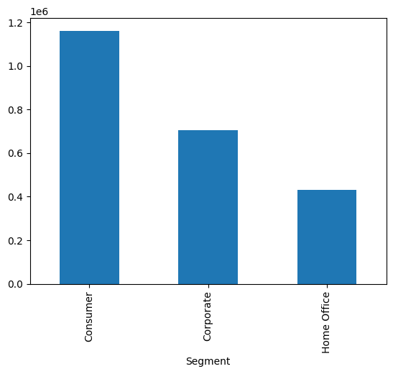
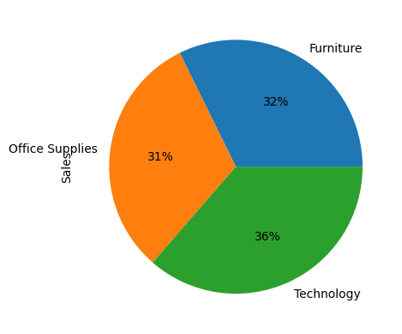
EDA Results:

Slide 7
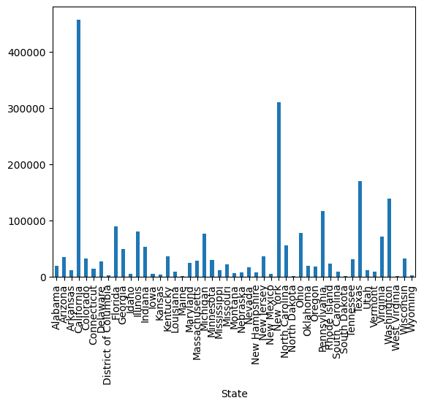
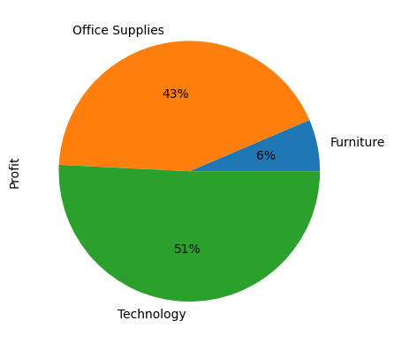
EDA Results:

Slide 8
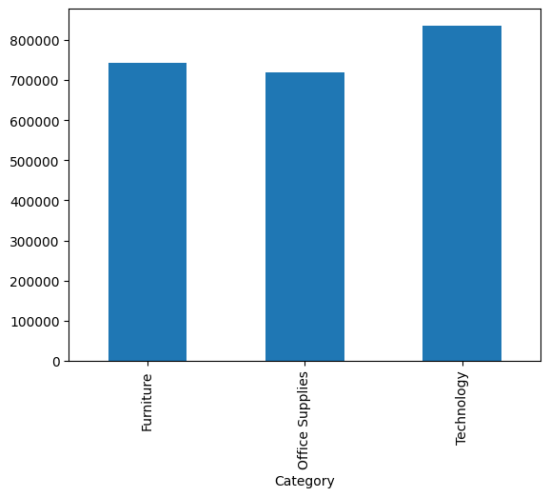
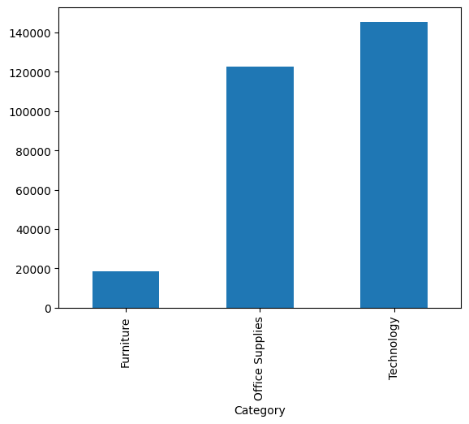
EDA Results:

Slide 9
Additional Notes:
The dataset is a sample superstore dataset acquired from Kaggle. It can be found at:
https://www.kaggle.com/datasets/bravehart101/sample-supermarket-dataset
All the code can be found in the Jupyter notebook hosted in my Drive here:
https://colab.research.google.com/drive/1oazcOqjC18u-aM8uOHuXE17ZBqDgo7FK?usp=sharing
The notebook contains more in-depth analysis along with more visualizations and graphs that I was not able to cover in the scope of this presentation. It contains more comparison graphs, KDE plots, etc.

Slide 10
Thank you
.
.

